Slide 1


우리 FISA 2025.09.26
AI 엔지니어링 - 2차 기술세미나
컴퓨터는 어떻게 텍스트 이미지를 읽을까?
OCR 알아보기
발표자 : 김성현

Slide 2
목차
01. 주제 선택 배경
02. OCR이란 어떤 기술인가?
03. 여러가지 데이터로 OCR해보기
04. 결론 및 향후 방향성
Notes:
목차는 둘중에 하나 선택해서 써!!

Slide 3

목차
01
주제 선택 배경
02
OCR이란 어떤 기술인가?
03
여러가지 데이터로 OCR해보기
04
결론 및 향후 방향성
Notes:
목차는 둘중에 하나 선택해서 써!!

Slide 4
주제 선택 이유

Slide 5
01
주제 선택 배경

Slide 6

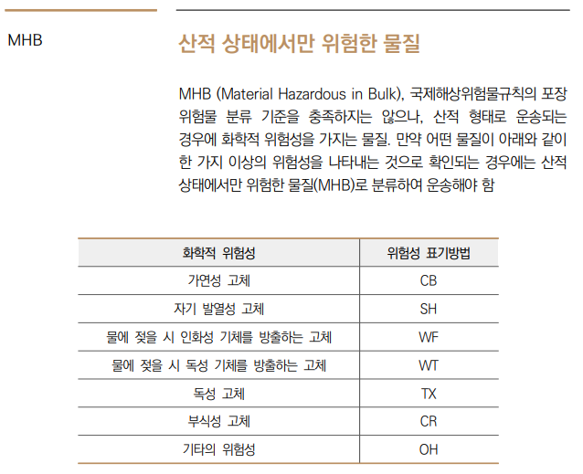
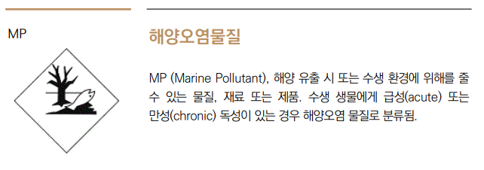
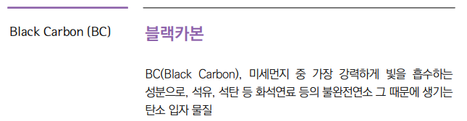
왜 OCR을??
PDF에서 텍스트를 추출해야 되는 상황

Slide 7
왜 OCR을??
PDF에서 텍스트를 추출해야 되는 상황

Slide 8
왜 OCR을??
PDF에서 텍스트를 추출해야 되는 상황

Slide 9
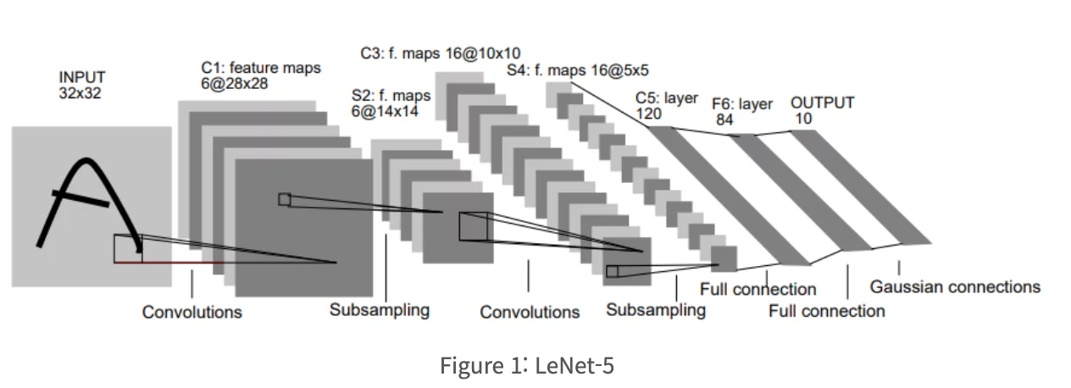
배운 CNN을 활용해서 충분히 가능!
https://healthyinsight.co.kr/%EC%9D%B4%EB%AF%B8%EC%A7%80-%EB%B6%84%EB%A5%98-cnn/

Slide 10
02
OCR이란
어떤 기술인가?

Slide 11
주제 선택 이유

Slide 12
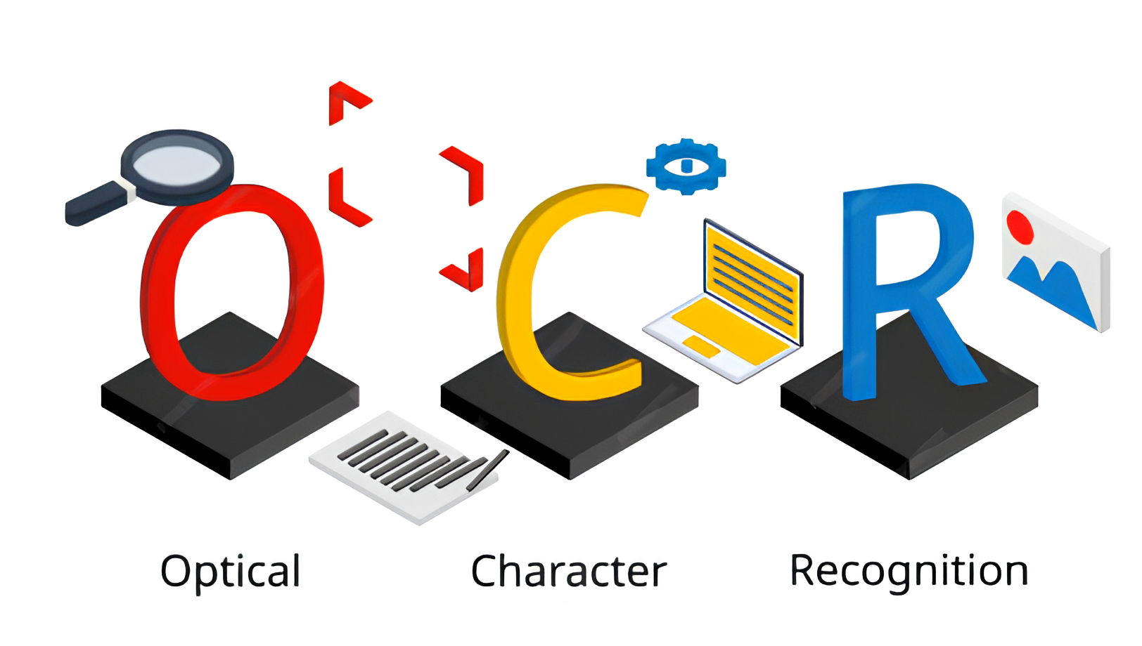
광학 문자 인식

Slide 13

기존 이미지 처리 방식과 차이점
CNN
C, A, T
OCR
CAT

Slide 14
OCR의 동작 방식

Slide 15
OCR(광학문자인식) 이란?

Slide 16

핵심 엔진 Tesseract

Slide 17
Regression

Slide 18
Segmentation

Slide 19
CRAFT

Slide 20
Pyramid Mask Text Detector

Slide 21
CRNN

Slide 22
CTC

Slide 23
TPS

Slide 24
03
여러가지 데이터로
OCR 해보기
Notes:
이것도 간지 둘중 하나 선택하기!!

Slide 25
제목기본틀

Slide 26

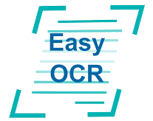
OCR 라이브러리
PyTesseract
EasyOCR
Unstructured

Slide 27
PyTesseract
PyTesseract
EasyOCR
Unstructured
26

Slide 28
PyTesseract

Slide 29
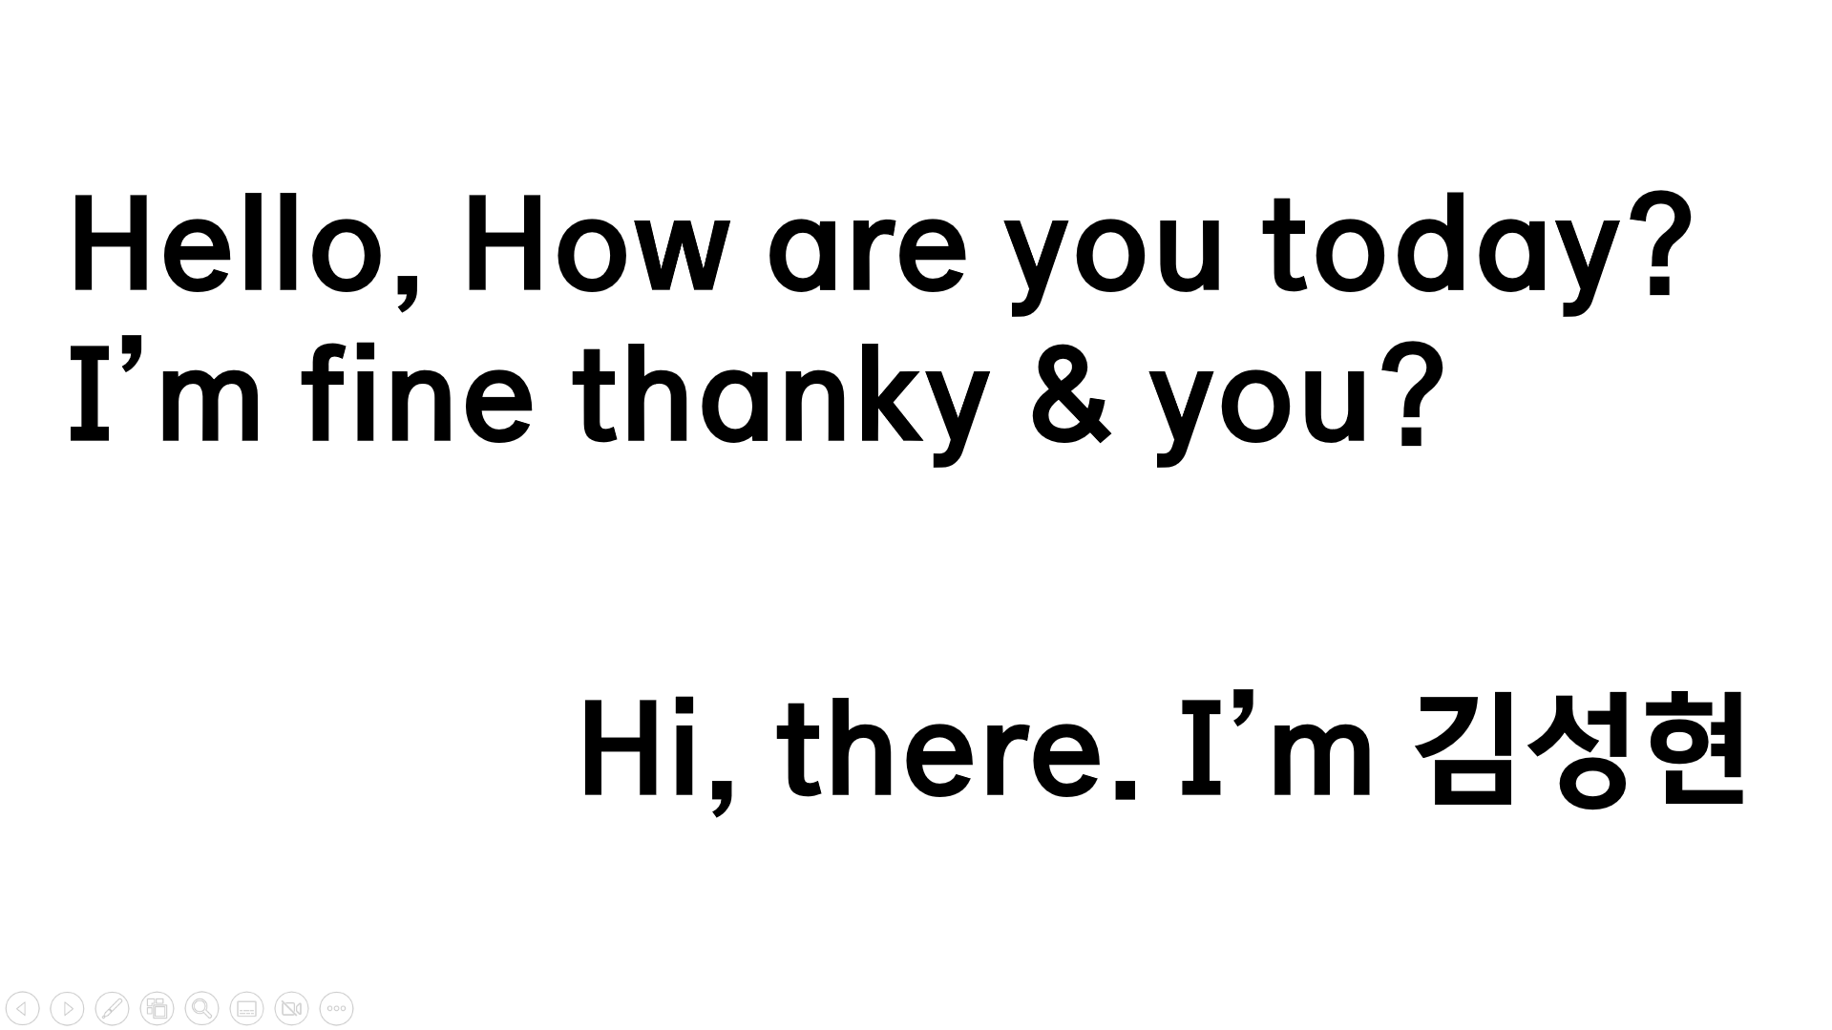
OCR Box
Test Image
 | Text | Confidence
0 |  | -1
1 |  | -1
2 |  | -1
3 |  | -1
4 | Hello, | 96
5 | How | 96
6 | are | 96
7 | you | 96
8 | today? | 95
9 |  | -1
10 | I’m | 83
11 | fine | 93
12 | thanky | 92
13 | & | 93
14 | you? | 96
15 |  | -1
16 |  | -1
17 |  | -1
18 | Hi, | 95
19 | there. | 87
20 | ‘m | 59
21 | ZY | 0

Slide 30
Test Image
OCR Box
 | Text | Confidence
0 |  | -1
1 |  | -1
2 |  | -1
3 |  | -1
4 | Hello, | 96
5 | How | 96
6 | are | 96
7 | you | 96
8 | today? | 95
9 |  | -1
10 | I’m | 83
11 | fine | 93
12 | thanky | 92
13 | & | 93
14 | you? | 96
15 |  | -1
16 |  | -1
17 |  | -1
18 | Hi, | 95
19 | there. | 87
20 | ‘m | 59
21 | ZY | 0

Slide 31
Test Image
OCR Box
 | Text | Confidence
0 |  | -1
1 |  | -1
2 |  | -1
3 |  | -1
4 | Hello, | 96
5 | How | 96
6 | are | 96
7 | you | 96
8 | today? | 95
9 |  | -1
10 | I’m | 83
11 | fine | 93
12 | thanky | 92
13 | & | 93
14 | you? | 96
15 |  | -1
16 |  | -1
17 |  | -1
18 | Hi, | 95
19 | there. | 87
20 | ‘m | 59
21 | ZY | 0

Slide 32
Test Image
OCR Box
 | Text | Confidence
0 |  | -1
1 |  | -1
2 |  | -1
3 |  | -1
4 | Hello, | 96
5 | How | 96
6 | are | 96
7 | you | 96
8 | today? | 95
9 |  | -1
10 | I’m | 83
11 | fine | 93
12 | thanky | 92
13 | & | 93
14 | you? | 96
15 |  | -1
16 |  | -1
17 |  | -1
18 | Hi, | 95
19 | there. | 87
20 | ‘m | 59
21 | ZY | 0

Slide 33
Test Image
OCR Box
 | Text | Confidence
0 |  | -1
1 |  | -1
2 |  | -1
3 |  | -1
4 | Hello, | 96
5 | How | 96
6 | are | 96
7 | you | 96
8 | today? | 95
9 |  | -1
10 | I’m | 83
11 | fine | 93
12 | thanky | 92
13 | & | 93
14 | you? | 96
15 |  | -1
16 |  | -1
17 |  | -1
18 | Hi, | 95
19 | there. | 87
20 | ‘m | 59
21 | ZY | 0

Slide 34
Test Image
 | Text | Confidence
0 |  | -1
1 |  | -1
2 |  | -1
3 |  | -1
4 | Hello, | 96
5 | How | 96
6 | are | 96
7 | you | 96
8 | today? | 95
9 |  | -1
10 | I’m | 83
11 | fine | 93
12 | thanky | 92
13 | & | 93
14 | you? | 96
15 |  | -1
16 |  | -1
17 |  | -1
18 | Hi, | 95
19 | there. | 87
20 | ‘m | 59
21 | ZY | 0
OCR Box

Slide 35
Test Image
 | Text | Confidence
0 |  | -1
1 |  | -1
2 |  | -1
3 |  | -1
4 | Hello, | 96
5 | How | 96
6 | are | 96
7 | you | 96
8 | today? | 95
9 |  | -1
10 | I’m | 83
11 | fine | 93
12 | thanky | 92
13 | & | 93
14 | you? | 96
15 |  | -1
16 |  | -1
17 |  | -1
18 | Hi, | 95
19 | there. | 87
20 | ‘m | 59
21 | ZY | 0
OCR Box

Slide 36
 | Text | Confidence
0 |  | -1
1 |  | -1
2 |  | -1
3 |  | -1
4 | Hello, | 96
5 | How | 96
6 | are | 96
7 | you | 96
8 | today? | 95
9 |  | -1
10 | I’m | 83
11 | fine | 93
12 | thanky | 92
13 | & | 93
14 | you? | 96
15 |  | -1
16 |  | -1
17 |  | -1
18 | Hi, | 95
19 | there. | 87
20 | ‘m | 59
21 | ZY | 0
OCR Box

Slide 37
 | Text | Confidence
0 |  | -1
1 |  | -1
2 |  | -1
3 |  | -1
4 | Hello, | 96
5 | How | 96
6 | are | 96
7 | you | 96
8 | today? | 95
9 |  | -1
10 | I’m | 83
11 | fine | 93
12 | thanky | 92
13 | & | 93
14 | you? | 96
15 |  | -1
16 |  | -1
17 |  | -1
18 | Hi, | 95
19 | there. | 87
20 | ‘m | 59
21 | ZY | 0
OCR Box

Slide 38
 | Text | Confidence
0 |  | -1
1 |  | -1
2 |  | -1
3 |  | -1
4 | Hello, | 96
5 | How | 96
6 | are | 96
7 | you | 96
8 | today? | 95
9 |  | -1
10 | I’m | 83
11 | fine | 93
12 | thanky | 92
13 | & | 93
14 | you? | 96
15 |  | -1
16 |  | -1
17 |  | -1
18 | Hi, | 95
19 | there. | 87
20 | ‘m | 59
21 | ZY | 0
OCR Box

Slide 39
 | Text | Confidence
0 |  | -1
1 |  | -1
2 |  | -1
3 |  | -1
4 | Hello, | 96
5 | How | 96
6 | are | 96
7 | you | 96
8 | today? | 95
9 |  | -1
10 | I’m | 83
11 | fine | 93
12 | thanky | 92
13 | & | 93
14 | you? | 96
15 |  | -1
16 |  | -1
17 |  | -1
18 | Hi, | 95
19 | there. | 87
20 | ‘m | 59
21 | ZY | 0
OCR Box

Slide 40
 | Text | Confidence
0 |  | -1
1 |  | -1
2 |  | -1
3 |  | -1
4 | Hello, | 96
5 | How | 96
6 | are | 96
7 | you | 96
8 | today? | 95
9 |  | -1
10 | I’m | 83
11 | fine | 93
12 | thanky | 92
13 | & | 93
14 | you? | 96
15 |  | -1
16 |  | -1
17 |  | -1
18 | Hi, | 95
19 | there. | 87
20 | ‘m | 59
21 | ZY | 0
OCR Box

Slide 41
 | Text | Confidence
0 |  | -1
1 |  | -1
2 |  | -1
3 |  | -1
4 | Hello, | 96
5 | How | 96
6 | are | 96
7 | you | 96
8 | today? | 95
9 |  | -1
10 | I’m | 83
11 | fine | 93
12 | thanky | 92
13 | & | 93
14 | you? | 96
15 |  | -1
16 |  | -1
17 |  | -1
18 | Hi, | 95
19 | there. | 87
20 | ‘m | 59
21 | ZY | 0
OCR Box

Slide 42
 | Text | Confidence
0 |  | -1
1 |  | -1
2 |  | -1
3 |  | -1
4 | Hello, | 96
5 | How | 96
6 | are | 96
7 | you | 96
8 | today? | 95
9 |  | -1
10 | I’m | 83
11 | fine | 93
12 | thanky | 92
13 | & | 93
14 | you? | 96
15 |  | -1
16 |  | -1
17 |  | -1
18 | Hi, | 95
19 | there. | 87
20 | ‘m | 59
21 | ZY | 0
OCR Box

Slide 43
 | Text | Confidence
0 |  | -1
1 |  | -1
2 |  | -1
3 |  | -1
4 | Hello, | 96
5 | How | 96
6 | are | 96
7 | you | 96
8 | today? | 95
9 |  | -1
10 | I’m | 83
11 | fine | 93
12 | thanky | 92
13 | & | 93
14 | you? | 96
15 |  | -1
16 |  | -1
17 |  | -1
18 | Hi, | 95
19 | there. | 87
20 | ‘m | 59
21 | ZY | 0
OCR Box

Slide 44
 | Text | Confidence
0 |  | -1
1 |  | -1
2 |  | -1
3 |  | -1
4 | Hello, | 96
5 | How | 96
6 | are | 96
7 | you | 96
8 | today? | 95
9 |  | -1
10 | I’m | 83
11 | fine | 93
12 | thanky | 92
13 | & | 93
14 | you? | 96
15 |  | -1
16 |  | -1
17 |  | -1
18 | Hi, | 95
19 | there. | 87
20 | ‘m | 59
21 | ZY | 0
OCR Box

Slide 45
 | Text | Confidence
0 |  | -1
1 |  | -1
2 |  | -1
3 |  | -1
4 | Hello, | 96
5 | How | 96
6 | are | 96
7 | you | 96
8 | today? | 95
9 |  | -1
10 | I’m | 83
11 | fine | 93
12 | thanky | 92
13 | & | 93
14 | you? | 96
15 |  | -1
16 |  | -1
17 |  | -1
18 | Hi, | 95
19 | there. | 87
20 | ‘m | 59
21 | ZY | 0
OCR Box

Slide 46
 | Text | Confidence
0 |  | -1
1 |  | -1
2 |  | -1
3 |  | -1
4 | Hello, | 96
5 | How | 96
6 | are | 96
7 | you | 96
8 | today? | 95
9 |  | -1
10 | I’m | 83
11 | fine | 93
12 | thanky | 92
13 | & | 93
14 | you? | 96
15 |  | -1
16 |  | -1
17 |  | -1
18 | Hi, | 95
19 | there. | 87
20 | ‘m | 59
21 | ZY | 0
OCR Box

Slide 47
 | Text | Confidence
0 |  | -1
1 |  | -1
2 |  | -1
3 |  | -1
4 | Hello, | 96
5 | How | 96
6 | are | 96
7 | you | 96
8 | today? | 95
9 |  | -1
10 | I’m | 83
11 | fine | 93
12 | thanky | 92
13 | & | 93
14 | you? | 96
15 |  | -1
16 |  | -1
17 |  | -1
18 | Hi, | 95
19 | there. | 87
20 | ‘m | 59
21 | ZY | 0
Text Extraction
OCR Box

Slide 48
 | Text | Confidence
0 |  | -1
1 |  | -1
2 |  | -1
3 |  | -1
4 | Hello, | 96
5 | How | 96
6 | are | 96
7 | you | 96
8 | today? | 95
9 |  | -1
10 | I’m | 83
11 | fine | 93
12 | thanky | 92
13 | & | 93
14 | you? | 96
15 |  | -1
16 |  | -1
17 |  | -1
18 | Hi, | 95
19 | there. | 87
20 | ‘m | 59
21 | ZY | 0
OCR Box
Text Extraction

Slide 49
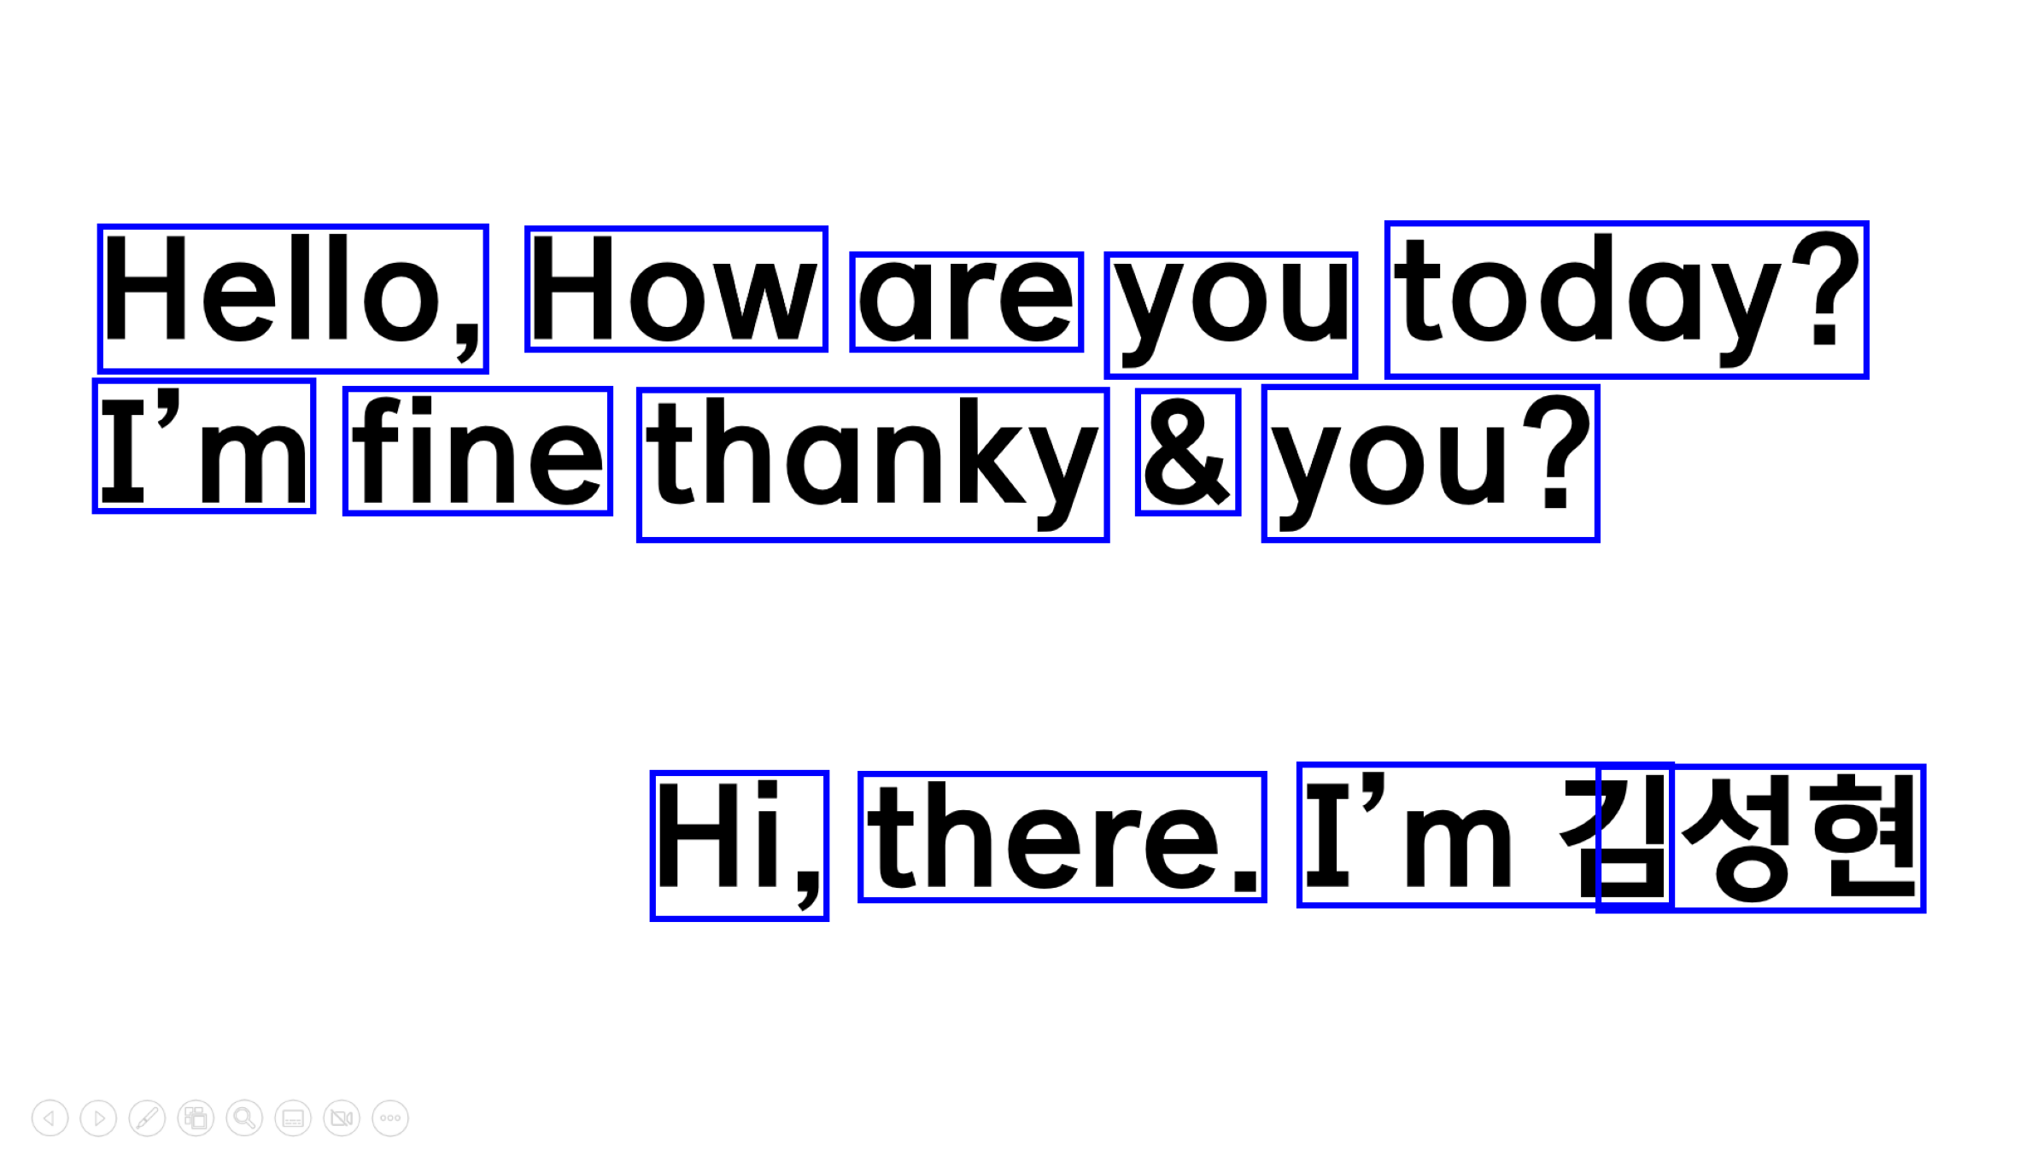
 | Text | Confidence
0 |  | -1
1 |  | -1
2 |  | -1
3 |  | -1
4 | Hello, | 96
5 | How | 96
6 | are | 96
7 | you | 96
8 | today? | 95
9 |  | -1
10 | I’m | 83
11 | fine | 93
12 | thanky | 92
13 | & | 93
14 | you? | 96
15 |  | -1
16 |  | -1
17 |  | -1
18 | Hi, | 95
19 | there. | 87
20 | ‘m | 59
21 | ZY | 0
OCR Box
Text Extraction
Hello, How are you today?
I’m fine thanky & you?
Hi, there. ’m 김성현

Slide 50
PyTesseract의 한계점

Slide 51
EasyOCR

Slide 52
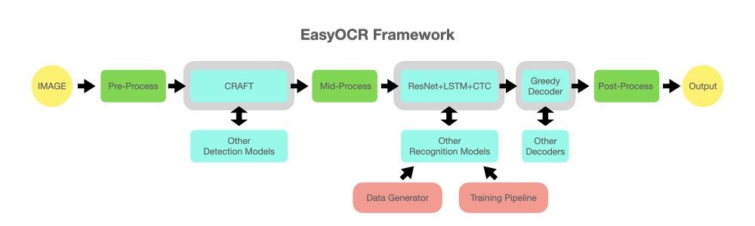
EasyOCR

Slide 53
Unstructured Partioning

Slide 54
04
결론 및 향후 방향성

Slide 55
성능 향상을 위한 이미지 전처리

Slide 56
현재 OCR의 한계점

Slide 57
이후.. 수집한 데이터는?

Slide 58
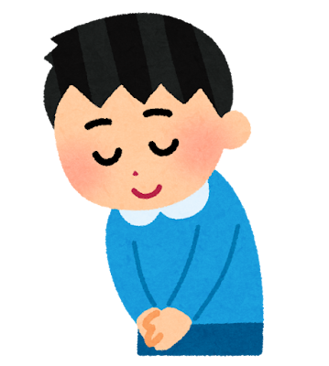
감사합니다 :>
Notes:
이거는 오빠가 알아서 꾸며도 될것같앙!!

